Slide 1
Social Data Mining
Assignment – 2
KEERTHY RAAJ SHANMUGAM

Slide 2

WEB SCRAPING FROM TWITTER AND REDDIT
Firstly, I scraped data from both Twitter and Reddit. Later, stored it in MongoDB.

Slide 3

POSTING TEXT FROM MY WEB APPLICATION TO TWITTER AND REDDIT
Secondly, we posted some text from our web application to my Twitter and Reddit accounts by creating a developers account.

Slide 4
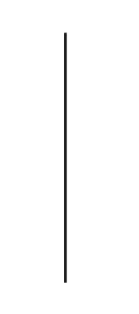



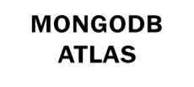




LANGUAGES AND TOOLS
PYTHON
HTML
CSS
JavaScript
Languages:
Tools:

Slide 5
LIBRARIES USED:
1.PANDAS
2.PYMONGO
3.FLASK
4.TWEEPY
5.PRAW

Slide 6
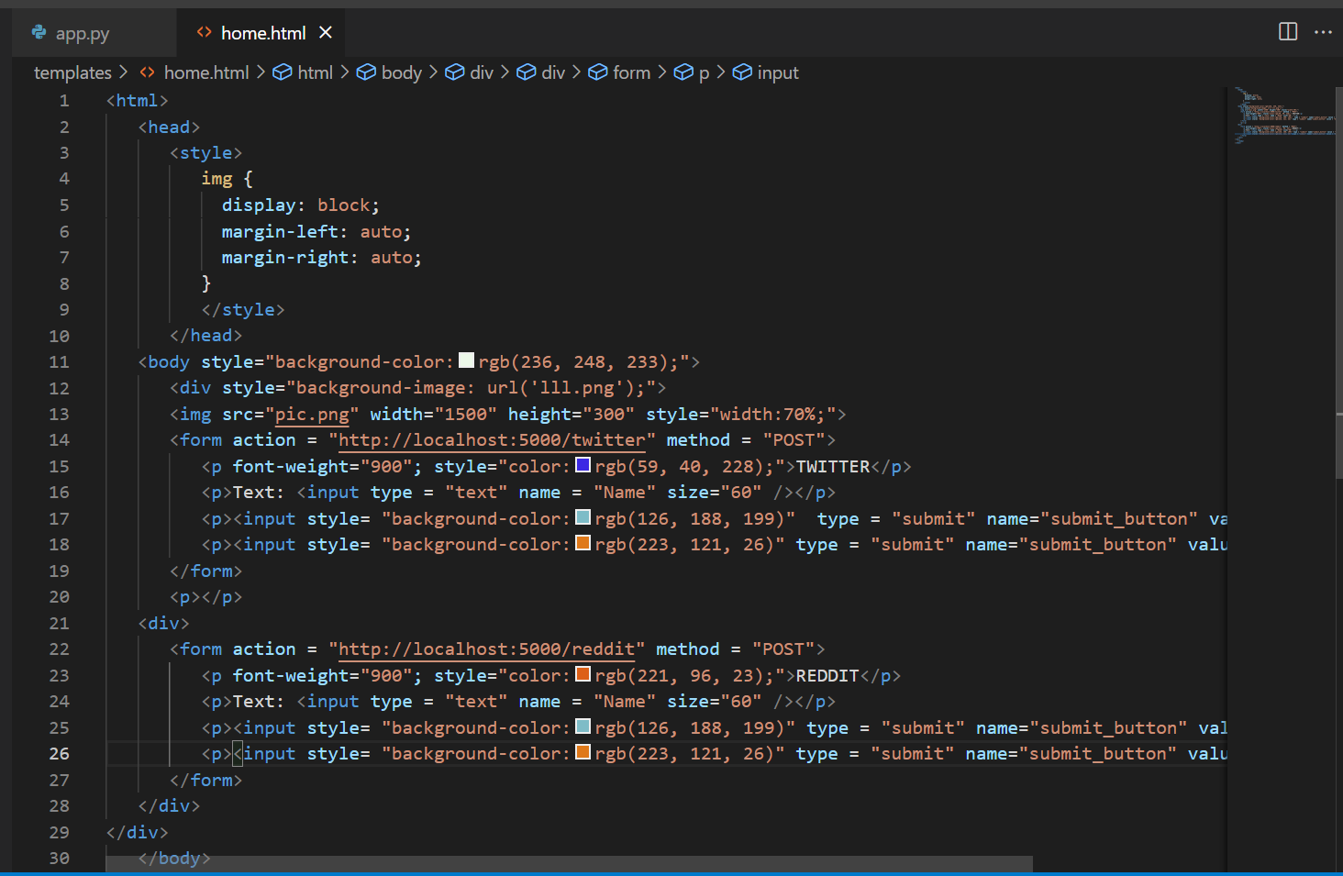
HTML CODE:
1.PANDAS
2.PYMONGO
3.FLASK
4.TWEEPY
5.PRAW

Slide 7
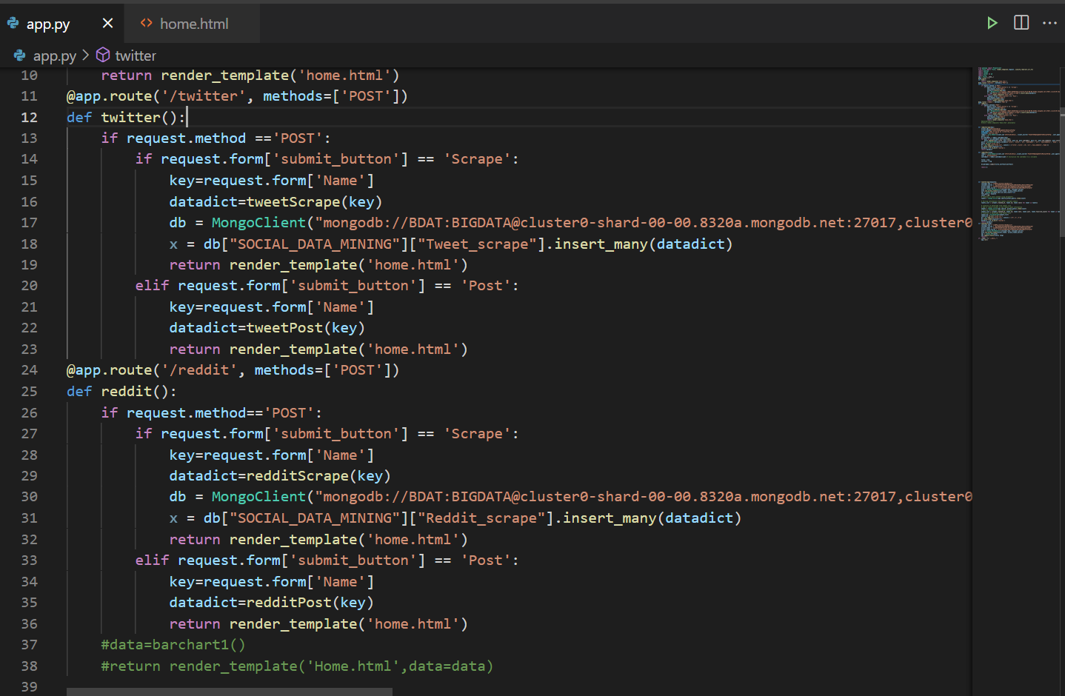
MONGODB CODE:
1.PANDAS
2.PYMONGO
3.FLASK
4.TWEEPY
5.PRAW

Slide 8
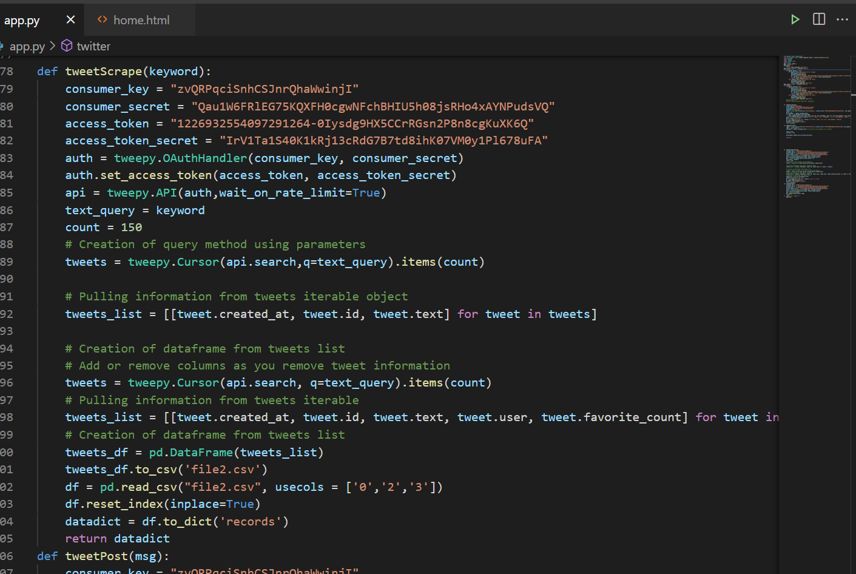
TWITTER CODE:
1.PANDAS
2.PYMONGO
3.FLASK
4.TWEEPY
5.PRAW

Slide 9
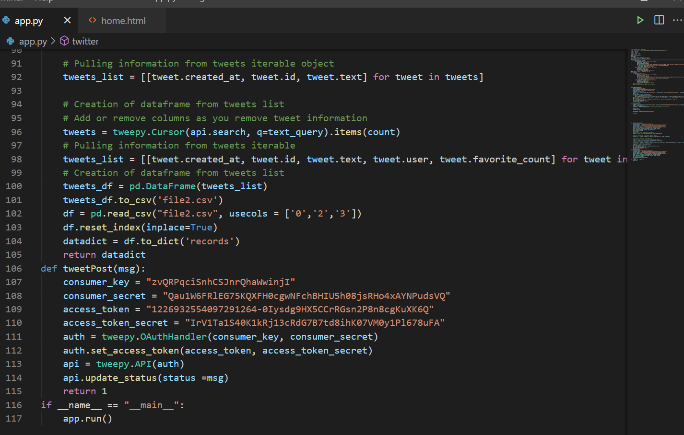
TWITTER CODE:
1.PANDAS
2.PYMONGO
3.FLASK
4.TWEEPY
5.PRAW

Slide 10
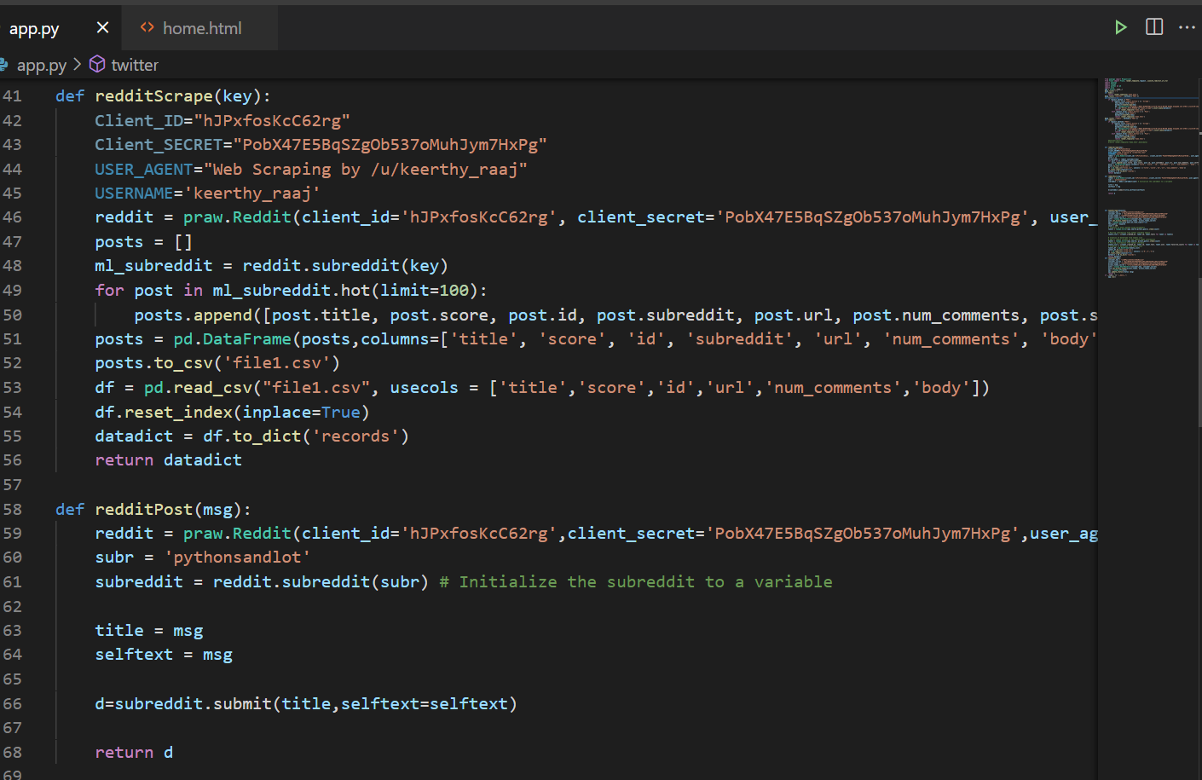
REDDIT CODE:
1.PANDAS
2.PYMONGO
3.FLASK
4.TWEEPY
5.PRAW

Slide 11
REFERENCES:
https://gilberttanner.com/blog/scraping-redditdata
https://www.jcchouinard.com/post-on-reddit-api-with-python-praw/
https://www.geeksforgeeks.org/tweet-using-python/

Slide 12
VIDEO LINK:
https://drive.google.com/file/d/1x2ZxoGSoUtdOPdVN207liCo1E-bw1D5G/view?usp=sharing

Slide 13
THANK YOU !

